Slide 1
Lessons from the Jungle of Open Source Big Data Development
Owen O’Malley, Co-founder Hortonworks
Apache Hadoop, Hive, ORC, and Incubator

Slide 2
History
Do something wonderful, people may imitate it.
- Schweitzer

Slide 3
In the Beginning…
Hadoop came out of web search
  Google web search team wrote GFS and MapReduce papers
  Large distributed batch jobs – throughput over latency
  Ran on commodity equipment – assume hardware fails
Amazing Architecture
  Implemented a filesystem that was append only
  No data choke points
  Reliability built into framework
  Automatic data and compute redundancy

Slide 4
Where Was I?
I was part of Yahoo’s WebMap team
  Built a graph of the crawled web
  100 billion URLS and 1 trillion links
  Implemented on custom C++ framework
  Took a month to run on 800 computers
We needed WebMap in a Week
  Wanted to build an open source solution
  Wanted the architecture from Google

Slide 5
Hadoop’s Humble Start
Started inside of Apache Nutch
  Nutch is a web-crawler
  Written in Java
Quickly split to new project
  First commit was 5kloc for HDFS and 6kloc for MapReduce
  Only scaled to a handful of machines
Took Yahoo’s investment to make it scale to hundreds of machines
  First users were data scientists
  Supporting WebMap took more than a year

Slide 6
Hadoop Grows Up
Users start putting data in to the Distributed File System
  At first, you need to convince each group to let you pull their data.
  Eventually, the groups want to push their data in to your cluster.
  Data has gravity – It pulls other data.
Once the data is in the DFS
  Trivial to access the data at scale.
  The data is OPEN and the user can pick the processing engine.
Provides a common security and auditing capabilities.

Slide 7
Apache & the Big Data Jungle
Be careful the environment you choose for it will shape you;
be careful the friends you choose for you will become like them.
- Stone

Slide 8
The Apache Way
Apache is a federation of projects
  Wide range of projects
  Choices such as Review-then-Commit or Commit-then-Review
Community over code
  Requires open development and governance
  Board never mandates technical direction
Meritocracy
  Give power to those doing good work.
  Individuals and not companies

Slide 9
Project Lifecycle
Projects are born a variety of ways
  Released on GitHub
  Contributed to Apache Incubator
  Split off of an existing Apache project
    Lucene➔ Nutch ➔ Hadoop ➔ Hive ➔ ORC
Gather community
  Users, Contributors, and Developers
When the community shrinks, the project goes idle
  Eventually retires to Apache Attic

Slide 10
Big Data Ecosystem
There are a LOT of Big Data projects
  When the environment changes, it creates a gap
  When there is a gap, one or more communities work to fill it
    Start a new project
    Modify an existing project
Projects that are similar compete
  For users and developers
  For publicity
  Tend to copy features from each other

Slide 11
To Fork or not to Fork
When another project does something that you need
  Do you use theirs directly? What if you need changes?
  Do you copy theirs and add the features?
  Do you start a new project?
Consider the cadence of the projects
  Younger faster projects can’t require changes from slower projects.
HBase forked Hadoop’s RPC
  It has meant a lot of duplicated work for both projects
  Inevitable since HBase was much younger and faster than Hadoop

Slide 12
User Isolation
It is important to have quiet time and isolation
- Burnside

Slide 13
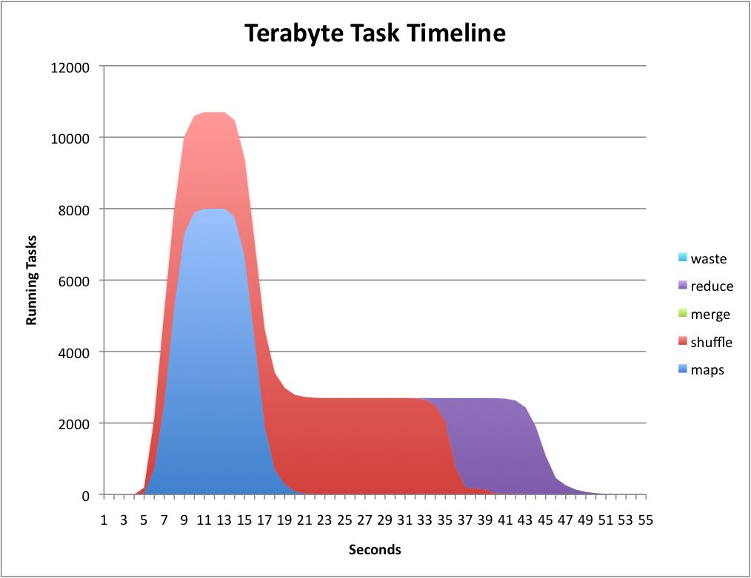
Hadoop On Demand
Early Hadoop didn’t isolate users well
Wanted ability to run different versions of HDFS & MapReduce
Created Hadoop On Demand (HOD)
  Used Torque cluster scheduler
  Allocated dynamic cluster
Didn’t adjust to MapReduce workload
  Wasted a lot of computer time

Slide 14
MapReduce Schedulers
Facebook wanted low latency
  Created Fair Share Scheduler
  Every application gets some resources
Yahoo wanted to maximize throughput
  Created Capacity Scheduler
  Allows multiple organizations to share a cluster with reserved capacity
Both plug in to MapReduce
Over time they have copied features from each other

Slide 15
Apache Mesos
Berkeley wanted to run different services on the same cluster
  Twitter was an early adopter via an intern from Berkeley.
Mesos arbitrates between different services to share cluster
  Offers available slots to each service
Support different versions of Hadoop
Users still interact with the individual service
Scales to many thousand machines
Security was an after thought

Slide 16
Mesos Architecture
MPI job
Hadoop job
MPI scheduler
Hadoop scheduler
Pick framework to offer resources to
Mesos
master
Allocation module
Resource offer
Mesos slave
Mesos slave
MPI executor
MPI executor
task
task

Slide 17
Apache YARN
Yahoo a lot of big-data use cases that weren’t MapReduce
  Machine learning
  MPI
  Graph Processing
Also needed to scale up MapReduce Clusters
  JobTracker was doing too much
  Stop dividing slots into Map vs Reduce
Needed security from the start

Slide 18
When all you have is a hammer…
Notes:
Due to massive storage and processing power users want to do many kinds of processing on Hadoop
But MR is sub-optimal for some things (e.g. SQL) and abysmal for others (e.g. machine learning)

Slide 19
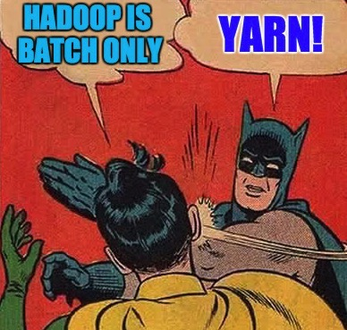
When all you have is a hammer…
Notes:
Solution: Hadoop 2.0 with YARN
Breaks out scheduling from execution so that other execution paradigms can run on Hadoop
Started in 2008, GA in 2013
Beginnings of a data operating system, storage plus scheduling

Slide 20
YARN Architecture

Slide 21
YARN’s Wins & Losses
Yahoo was able to increase utilization
  Big cluster went from 80k to 125k jobs
  Doubled CPU utilization
  Was able to retire 1000 machines
Many different frameworks run on Hadoop clusters now
Complex API
  Split brain handling left to application
Emerging support for standing services

Slide 22
Yahoo YARN Job Distribution

Slide 23
Higher Level Tools
I don’t like to crack an egg with a sledgehamer.
- Dijkstra

Slide 24
Hadoop Streaming
One of the data scientists wanted to use python for MapReduce
He implemented a framework to use subprocesses
  Used stdin & stdout to transfer data
Allowed python, shell scripts, etc. to be used for MapReduce.
Mappers and Reducers were much easier to debug.
No higher level grouping of jobs

Slide 25
Apache Pig
Yahoo wanted an easier way to encode data flows.
User defines data flows in Pig Latin.
  Users don’t need to learn details of optimizing MapReduce.
At one point 60% of Yahoo’s jobs were Pig.
  Twitter is also a big user.
Strong support for User Defined Functions.
Read-Eval-Print-Loop “Grunt” shell
System builds a set of MapReduce jobs.

Slide 26
Apache Hive
Facebook wanted to use SQL for Hadoop jobs.
  SQL is the common language for data queries.
  SQL support is important for tool-interoperability.
  Framework generated MapReduce jobs from query.
Has a Metastore for storing information about tables
  Has become the standard location for finding tabular data
  Used by Impala, Presto, Spark SQL, etc.
The original optimizer was a mess of custom rules.
  Improving with new use of Calcite - a SQL optimizer framework

Slide 27
Apache Impala
Cloudera wanted a faster Hadoop SQL Engine.
  Started as a GitHub project, closed to external contribution.
  Eventually moved to Apache
More standard SQL
Faster answers than Hive
  Users didn’t have to wait 30 minutes for their answer
Dedicated servers
  No MapReduce jobs

Slide 28
Apache Hive Redux
Impala moved the goal for Hadoop SQL.
  Had to be able to get faster answers.
We decided to improve Hive rather than start over.
  Added support for multiple backends - MapReduce, Tez, eventually Spark
  Improve SQL compatibility
  Vectorization processing
  Columnar storage – ORC
Tez provides arbitrary task DAG instead of MapReduce’s two levels.
  Used for Hive, Pig, and Cascading
  Not intended for non-frameworks

Slide 29
Acquiring Data
It is a pretty frantic world that we live in.
- Carpenter

Slide 30
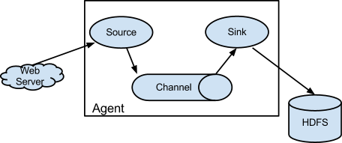
Apace Flume
Yahoo had a proprietary framework for importing
  But others did not
Need a framework for continually storing new data
Apache Flume was created
  Push model
  Difficult to build data splits
  No replication
  No security

Slide 31
Apache Kafka
LinkedIn wanted a better solution
Talked to Flume team, but couldn’t see eye to eye.
Pull model
Data replication
Flow splits
Security

Slide 32
Apache NiFi
Meanwhile, the NSA was working on their own
Powerful operations console
Multi-stage flows
Cross datacenter
Backtalk protocol
Security

Slide 33
Using Memory
Yesterday’s just a memory.
- Dylan

Slide 34
Apache Spark
When we started with Hadoop, the machines had 8 GB.
That number has grown quickly over the years.
Berkeley created Spark to support iterative Machine Learning.
  Possible with MapReduce, but requires a long chain of jobs.
  Keeping intermediate results in memory (RDD) improves speed
  Distributed computation over RDDs
Spark has grown over the years to have many integrated modules
  Graph Processing, Machine Learning, SQL, Streaming

Slide 35
Apache Spark Wins & Losses
Excellent APIs
Read-Evaluate-Print Loop (REPL)
Cross-framework handoffs are well managed
  Not best in class for any particular field, but the synergy is impressive
Umbrella project, which is difficult to manage
Long curve to take proof-of-concept to production
  Quick to develop POC
  Production system takes much longer

Slide 36
LLAP – Live Long & Process
We’d optimized Hive a lot, but we wanted more.
  In particular, we wanted sub-second responses to queries
Java Virtual Machines (JVM) start up is really slow
  Lots of IO
  Lots of CPU for the Just-In-Time compiler
  A second to start and another second before throughput is good
Solution was to leave processes running
  Cache hot columns and partitions
  Enforce consistent security
  Process 6 billion row table < 1 second

Slide 37
LLAP Architecture

Slide 39
Refactoring Code
The Only Thing That Is Constant Is Change.
- Heraclitus

Slide 40
Splitting Hadoop
We tried splitting Hadoop into logical parts
  Common
  HDFS
  MapReduce
Failed to account for communities
  There was no community for Common
Ant build system made it difficult to release separately.
  We needed Maven and Nexus to make it work
Java’s class loaders make deploying shared libraries hard.

Slide 41
Moving ORC out of Hive
ORC is a columnar file format
  Originally built in to Hive for good usability
  But we wanted to move it out for easier integration with other tools
Over the years, it had become entangled
  Took a couple of failed passes
  Depended on 16,000 classes outside of Hadoop & Protobuf
Built a custom tool to analyze class dependencies
  Root set of “ORC” classes
  Ignore “system” classes – Java, Hadoop, Protobuf
  Sorted by depth from root classes and transitive dependency weight

Slide 42
API Compatibility
General agreement that breaking public APIs is bad.
  Source versus binary compatibility
  Major version allow it, but it still hurts users.
Disagreement whether something is public API.
  Java visibility keywords have the wrong semantics for this.
  Mostly use Google, Hadoop, or Yetus visibility annotations.
Hard to know many users are using a particular feature.
Would be great to mine Github and Maven Central to gather data.

Slide 43
Google’s Environment
Google rebuilds their entire stack every night
  That means that backwards compatibility isn’t important to them.
Protobuf and Guava regularly break backwards compatibility
  Google views Protobuf incompatibility as a feature.
  Everyone should regenerate code with the “current” version.
Rest of world pulls binary jars from Maven Central.
  Entire stack of projects needs to agree on Protobuf version.
  Or everyone needs to shade the Protobuf classes.

Slide 44
Final Thoughts
Software Engineers need to aggressively learn new things
In the long run, open source wins
Internships at companies provide great opportunities
Tools make a huge difference in what you can do.
  The current tools (eg Maven) make it easy to create layers.
Environments change and the ecosystem adapts.
  Understanding a tool’s original environment is critical
Distributed systems are different from traditional ones
  But design patterns transfer

Slide 45
Thank You

